Slide 1
Dynamically Implementing the Gutzwiller Projection
Garrett Stoll, Dr. Vito Scarola

Slide 2

What is the Gutzwiller Projection?

Slide 3
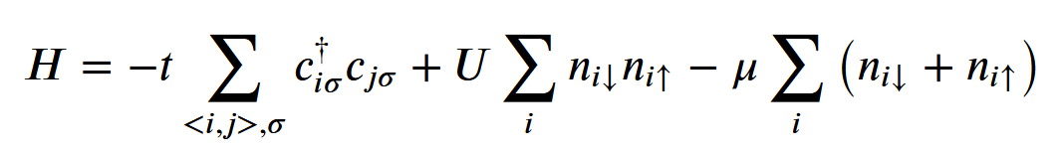
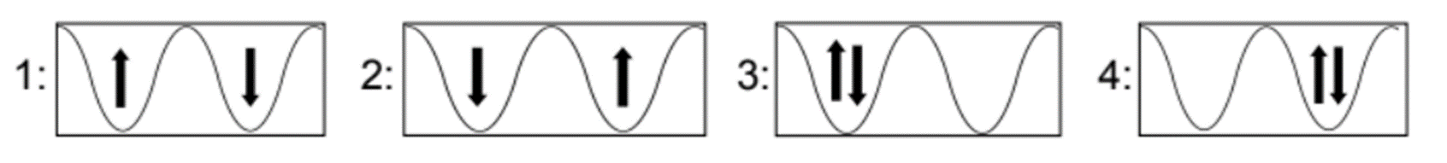
Hubbard Model
An approximate model of quantum particles in a lattice
t (kinetic/hopping term)
U (potential/double occupancy penalty)
μ (chemical potential)

Slide 4

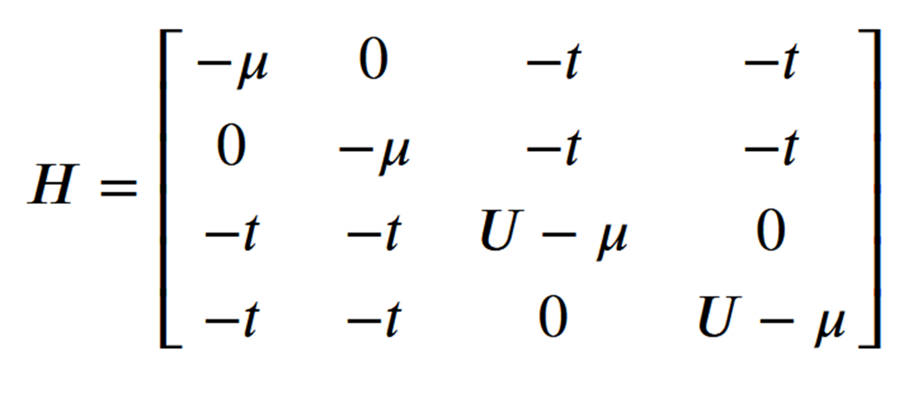
Matrix Form

Slide 5
Why the Hubbard Model?
Simulating ultra cold fermionic gases in optical lattices can help us understand many-body quantum systems (Esslinger 2010)
“high degree of controllability, the novel detection possibilities and the extreme physical parameter regimes” (Bloch 2012)

Slide 6

Overview
Process:
Computationally simulate the model
Collect the data
Visualize the data
Analyze the data
What I learned:
Many-body quantum system
Time evolution (e^{-iHτ})
Skills used:
Python
Linear algebra
Parallel Computing
Data Visualization

Slide 7

Rundown
UUU
ψ_{j}
Antiferromagnetic
Singly Occupied
Doubly Occupied
UUU
UUU
UUU
ψ_{k}

Slide 8
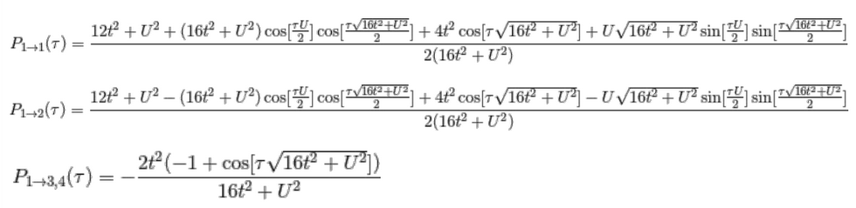
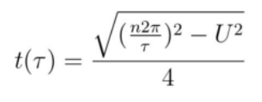
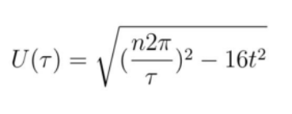
Lance Miller’s Solutions

Slide 9
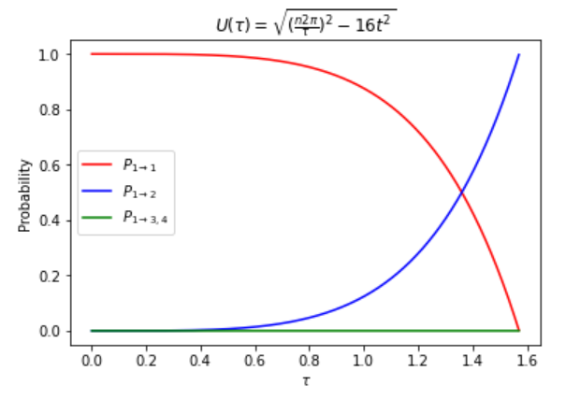
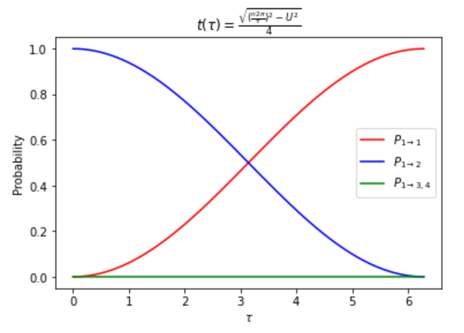
Testing Lance’s Solution

Slide 10
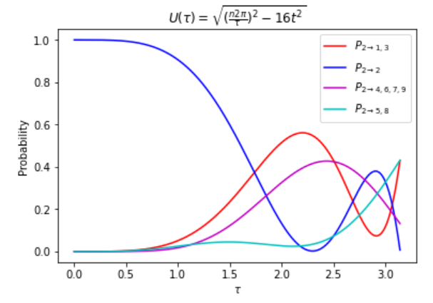
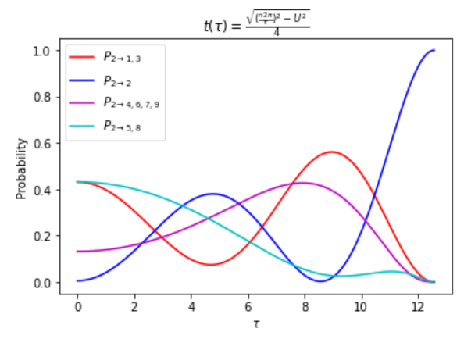
Testing 3-sites

Slide 11
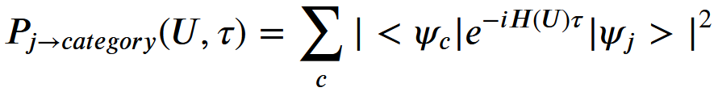
Probability Map

Slide 12
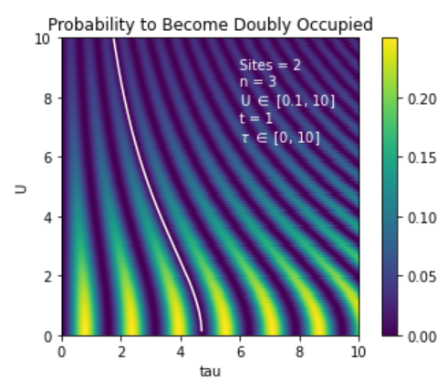
2-site U(τ)

Slide 13
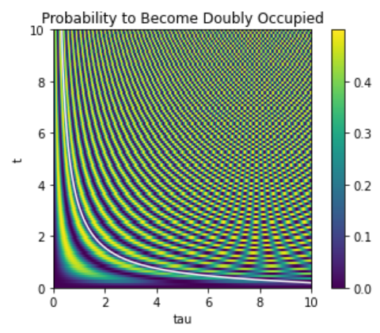
2-site t(τ)

Slide 14
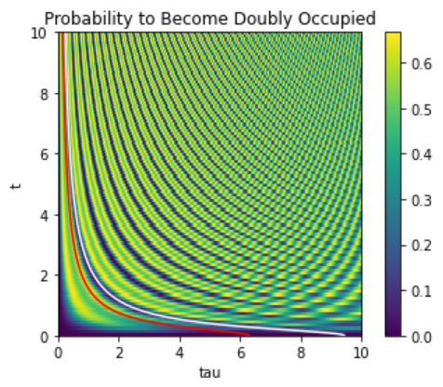
3-site t(τ)

Slide 15
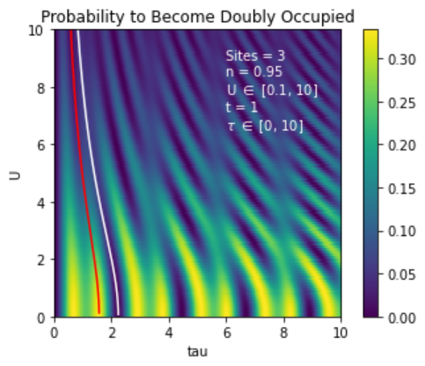
3-site U(τ)

Slide 16
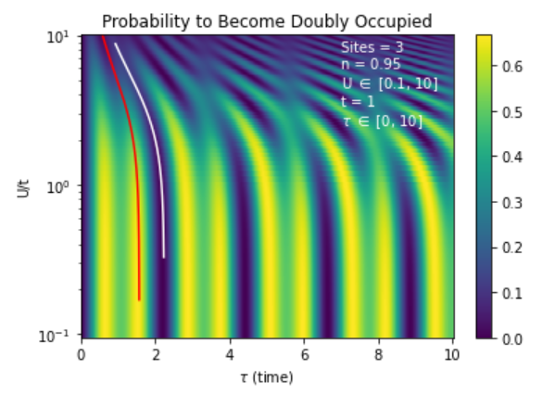
3-site U(τ) log plot

Slide 17
get_basis(model)
List of all possible states
[1,1,0] [i,0,0]
Permutate
[ [1,1,0],[1,0,1],[0,1,1] ] [ [i,0,0],[0,i,0],[0,0,i] ]
[ [ 1+i, 1, 0 ], [ 1, 1+i, 0 ], [ 1, i, 1 ], … ]

Slide 18
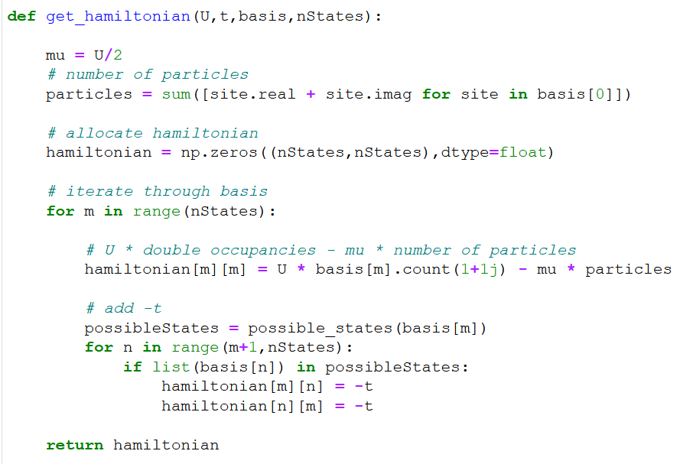
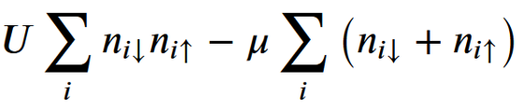
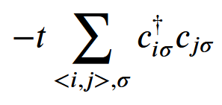

Slide 19
get_stateindexes(cat)
Vector of 0s and a 1, indicating the index of the state in the basis
State #2 for two-site: [0, 1, 0, 0]^{T}
cat (int)
0 -> antiferromagnetic states
1 -> singly occupied states
2 -> doubly occupied states
Return list of state vectors
ψ

Slide 20
timeEvol(H,psi,tau,cat)
Scipy.linalg.expm()
Pade approximmation

Slide 21
Parallelize
Used skills from CMDA 3634
multiprocessing
MPI4Py

Slide 22
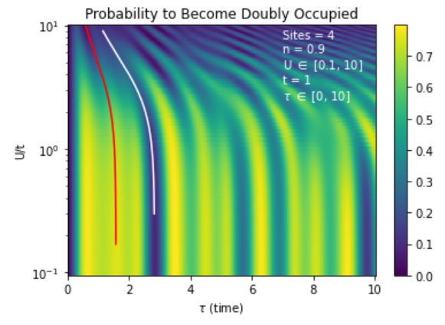
4-sites U(τ)

Slide 23
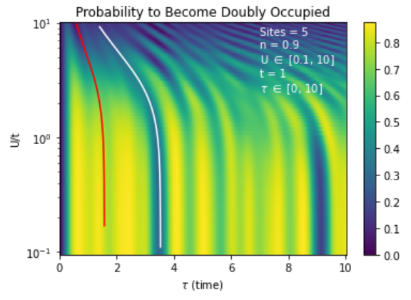
5-sites U(τ)

Slide 24
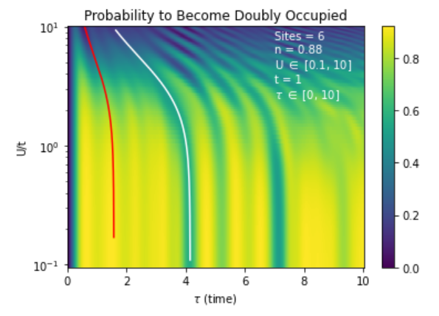
6-sites U(τ)

Slide 25
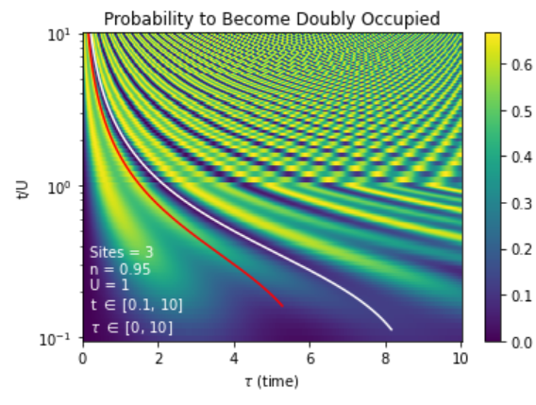
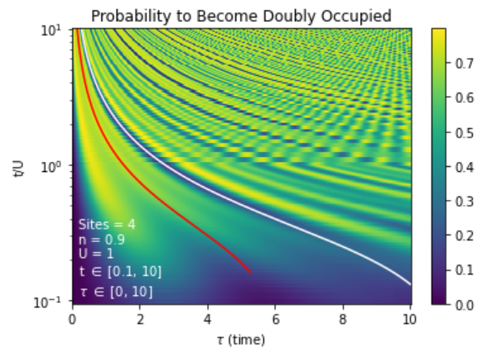

Slide 26
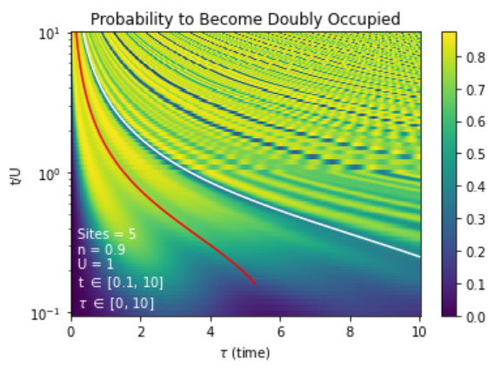
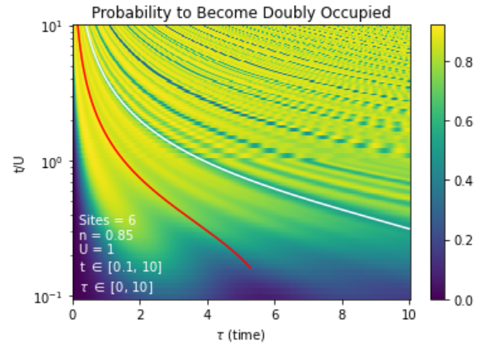

Slide 27
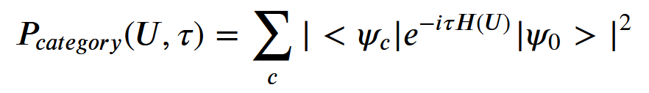
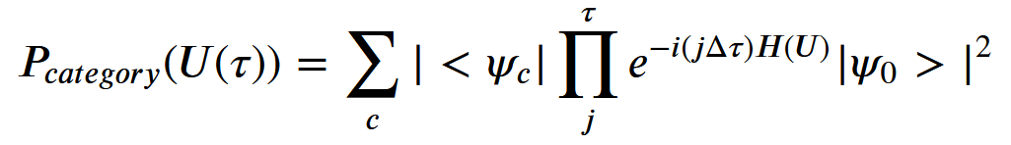
New Work

Slide 28
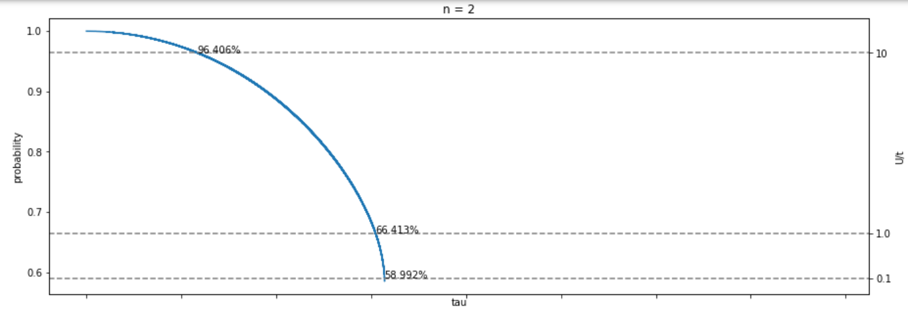
Actual Results

Slide 29
New Probability Map
Recursive function that returns a tree diagram
Probability constraint
Looking to constrain U
U
τ

Slide 30
References
Esslinger, Tilman. Fermi-Hubbard Physics with Atoms in an Optical Lattice. Annual Review of Condensed Matter Physics 2010 1:1, 129-152
Bloch, I., Dalibard, J. & Nascimbène, S. Quantum simulations with ultracold quantum gases. Nature Phys 8, 267–276 (2012). https://doi.org/10.1038/nphys2259
Miller, Lance and Vito Scarola. Dynamically Engineering Gutzwiller Projection. Poster presented at: Name of Conference; Date of Conference; Location of Conference.

